Slide 1
How to work on a data set
By
Dr. Inam Ullah Khan

Slide 2
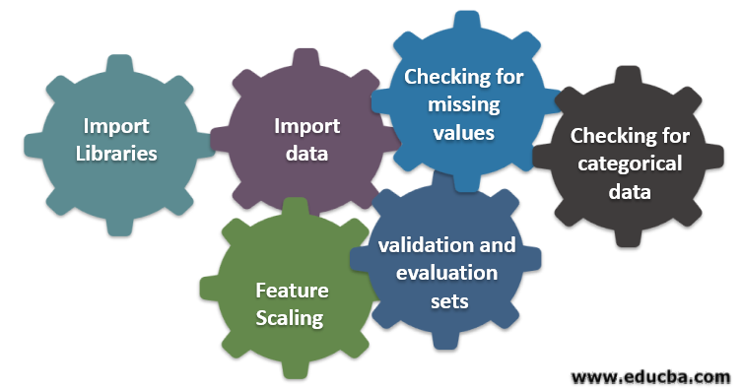
Data Preprocessing
Why preprocess the data?
Data cleaning
Data visualization
Removing null values

Slide 3
Why Data Preprocessing?
Data in the real world is dirty
  incomplete: missing attribute values, lack of certain attributes of interest, or containing only aggregate data
    e.g., occupation=""
  noisy: containing errors or outliers
    e.g., Salary="-10"
  inconsistent: containing discrepancies in codes or names
    e.g., Was rating "1,2,3", now rating "A, B, C"
    e.g., discrepancy between duplicate records

Slide 4
I Why Is Data Preprocessing Important?
No quality data, no quality mining results!
  Quality decisions must be based on quality data
    e.g., duplicate or missing data may cause incorrect or even misleading statistics.
Data preparation, cleaning, and transformation comprises the majority of the work in a data mining application (90%).

Slide 5

Data Cleaning
Importance
  "Data cleaning is the number one problem in data warehousing"
Data cleaning tasks
  Fill in missing values
  Correct inconsistent data

Slide 6
Missing Data
Data is not always avaiIable
  E.g., many tuples have no recorded values for several attributes, such as customer income in sales data
Missing data may be due to
  equipment malfunction
  inconsistent with other recorded data and thus deleted
  data not entered due to misunderstanding
  certain data may not be considered important at the time of entry
  not register history or changes of the data

Slide 7
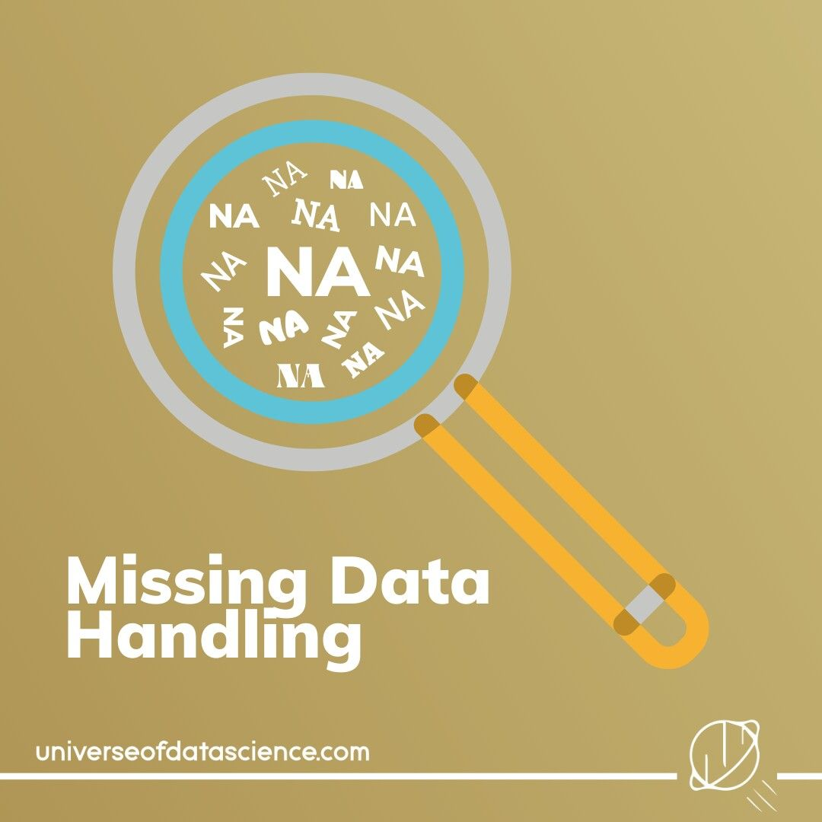
How to Handle Missing Data?
Ignore the tuple
Fill in missing values manually
Fill in it automatically

Slide 8
Noisy Data
Noise: random error or variance in a measured variable.
Incorrect attribute values may due to
  faulty data collection instruments
  data entry problems
  data transmission problems
  etc
Other data problems which requires data cleaning
  duplicate records, incomplete data, inconsistent data

Slide 9
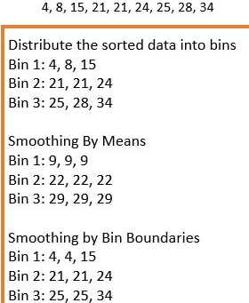
How to Handle Noisy Data?
Binning method:
  first sort data and partition into (equi-depth) bins
  then one can smooth by bin means, smooth by bin median, smooth by bin boundaries, etc.

Slide 10
How to Handle Noisy Data?
Clustering
  detect and remove outliers
Combined computer and human inspection
  detect suspicious values and check by human (e.g., deal with possible outliers)

Slide 11
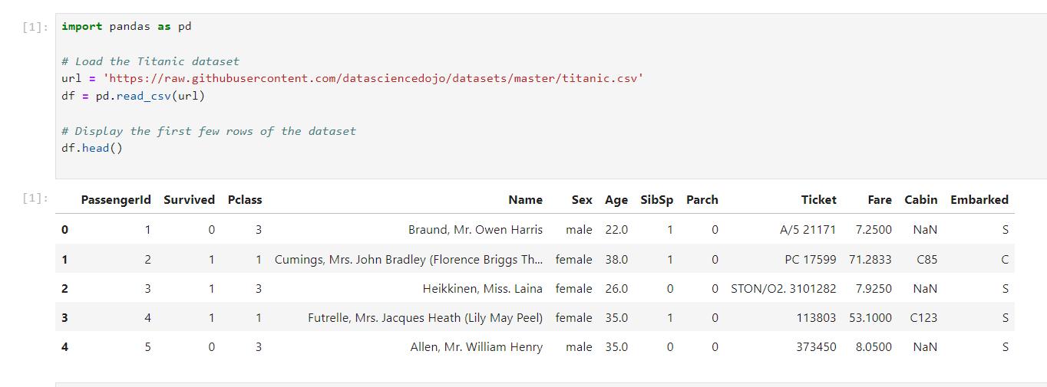
Loading data

Slide 12
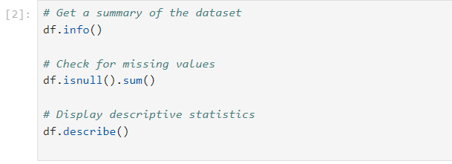
Explore the dataset

Slide 13
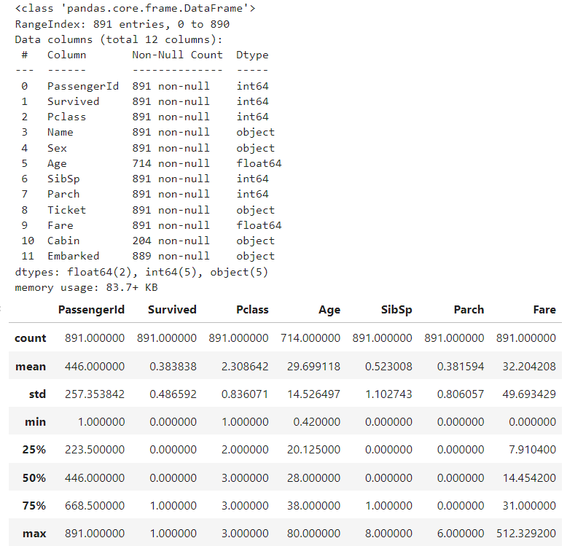
Loading data

Slide 14
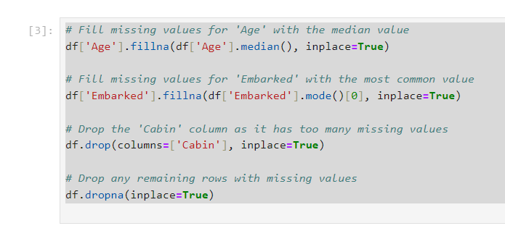
Handle missing values

Slide 15
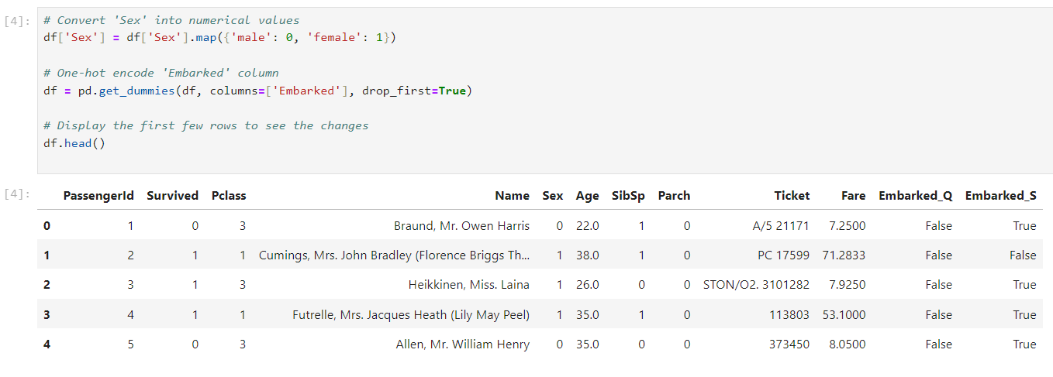
Convert categorical features to numerical

Slide 16
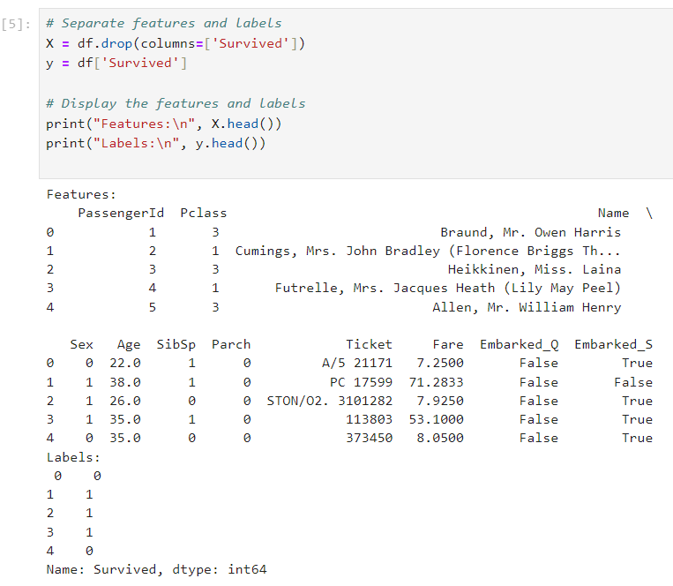
Label the data

Slide 17
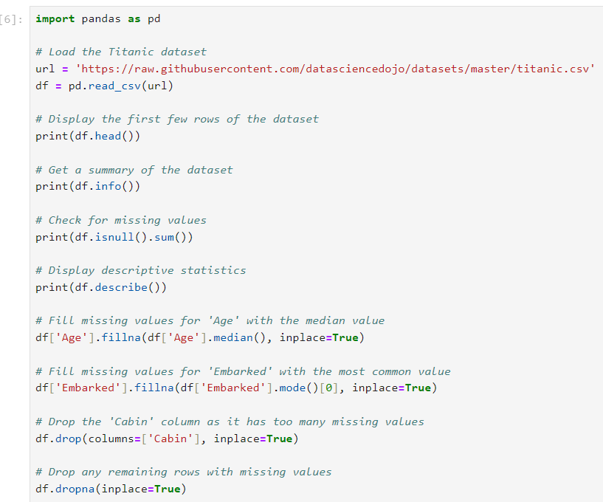
Full code

Slide 18
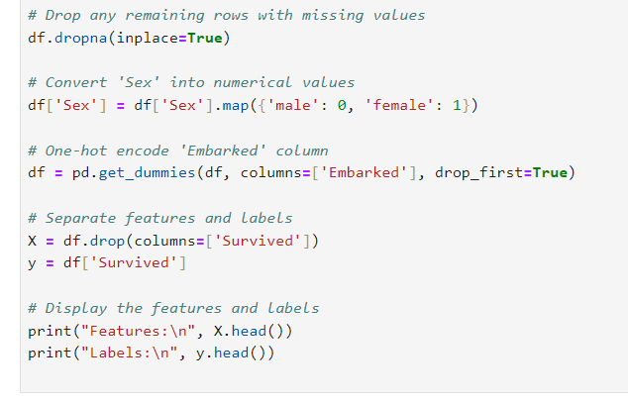

Slide 19
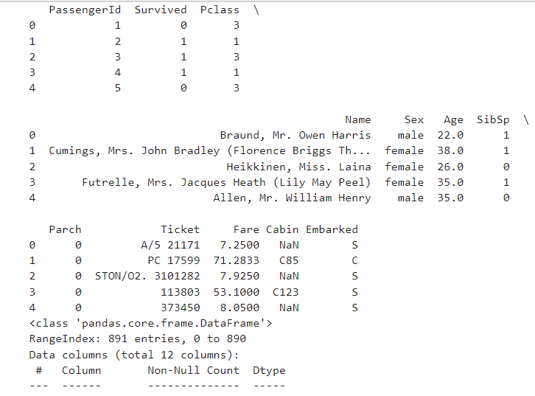

Slide 20
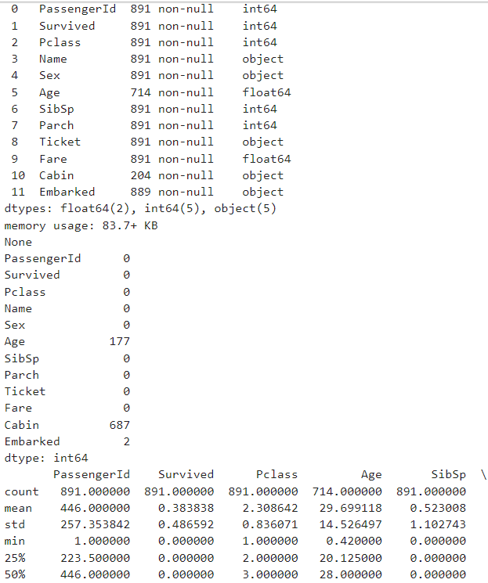

Slide 21
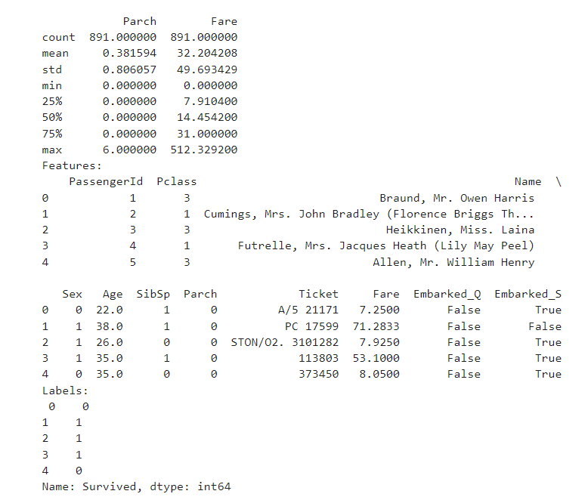

Slide 22
Thank you for your Attention
If you have any questions feel free to ask

